Slide 1
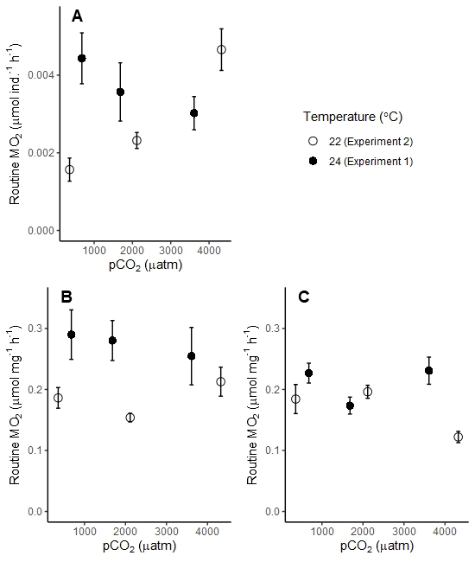
b
a
a
a
a
b

